Slide 1
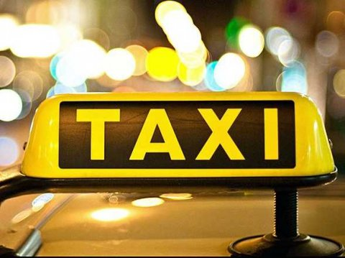
NYC Taxi Data Analysis
Programming for Big Data Presentation
Yuankai Wang • Luyao Chen • Yalin Zhuang

Slide 2
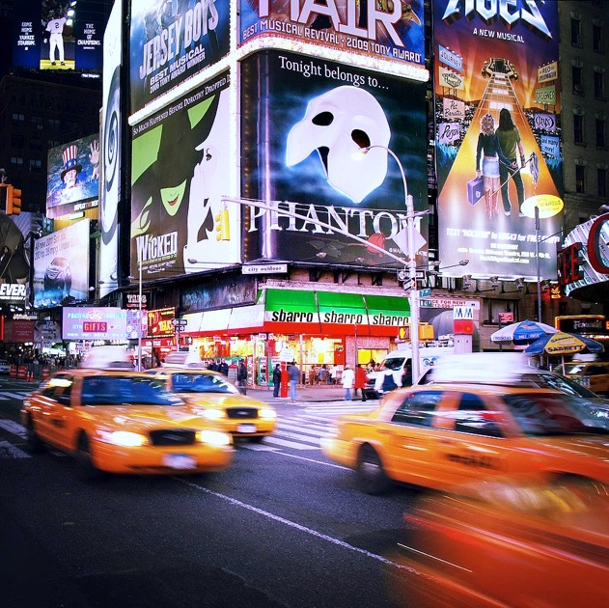
DATA ANALYSIS
CONTENT
NYC DATA ANALYSIS REPORT
ANALYZE POSITION: K-MEANS
TRANSPORTATION CHANGES

Slide 3
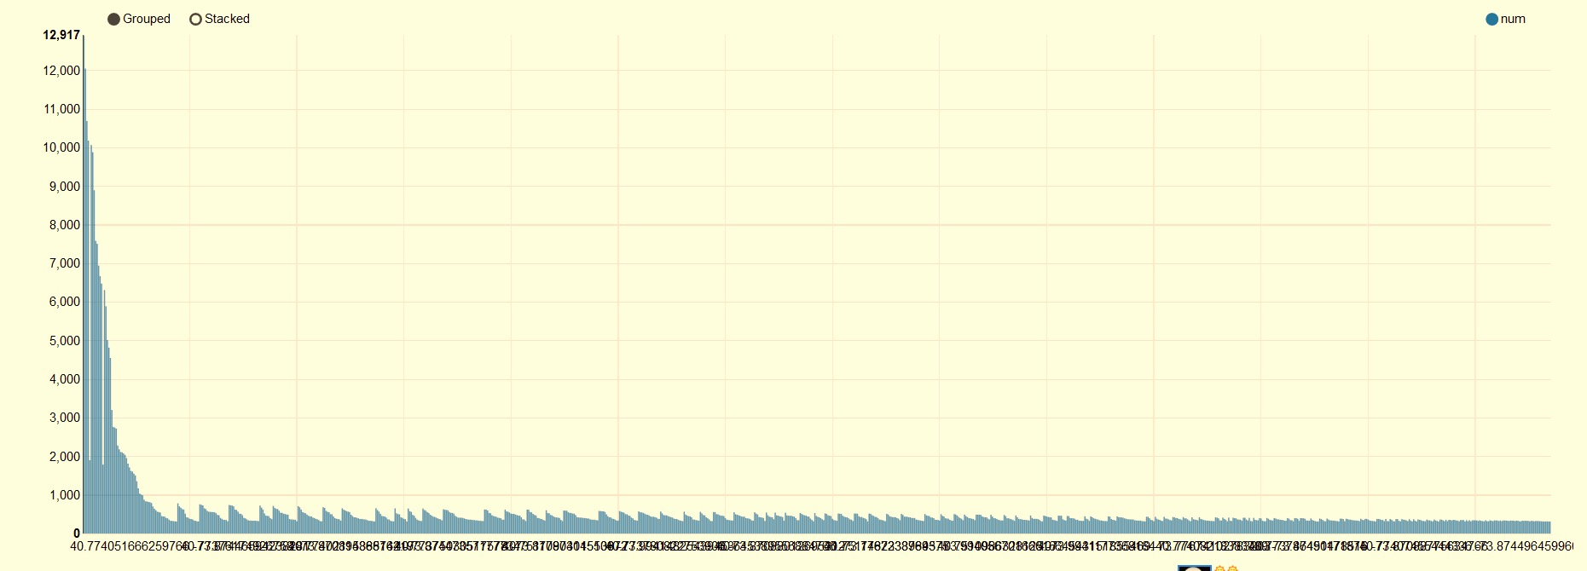
NYC TAXI DATA ANALYSIS
1. POSITION

Slide 4
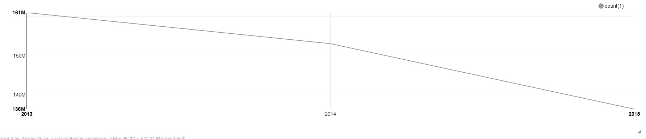
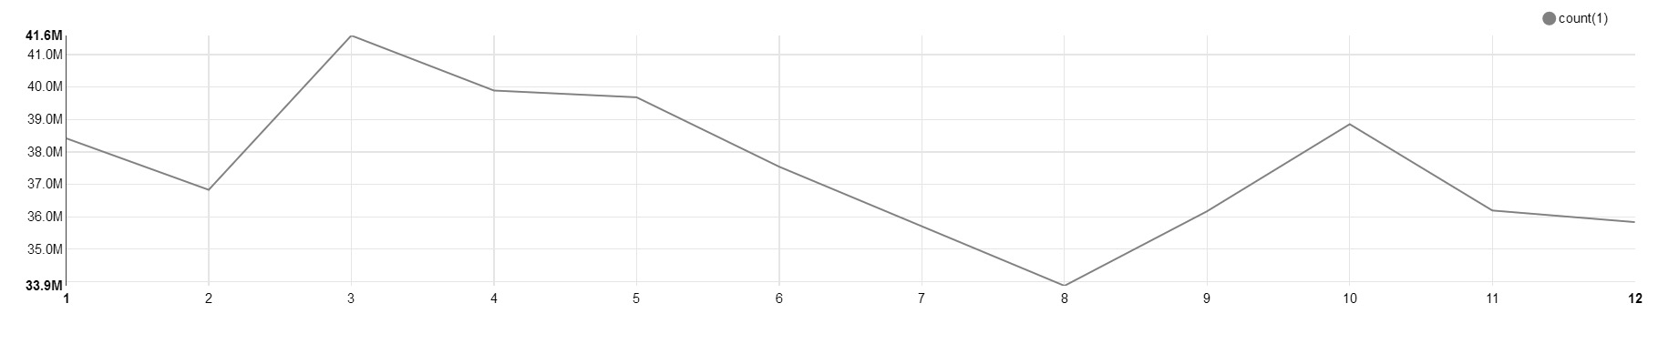
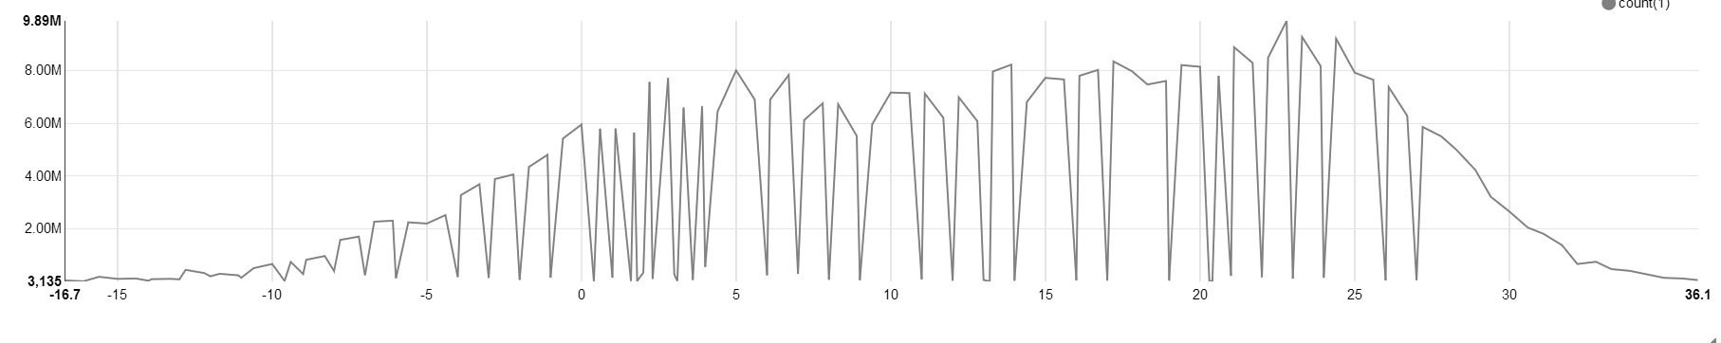
NYC TAXI DATA ANALYSIS
2. YEAR
3. MONTH
4. TEMPERATURE

Slide 5
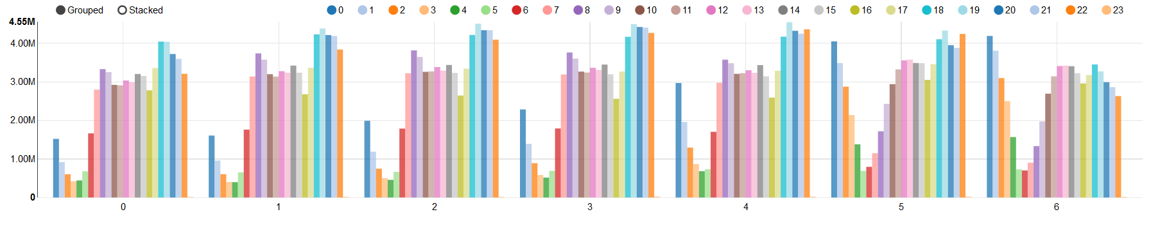
NYC TAXI DATA ANALYSIS
5. TIME
0-6: Monday to Sunday
Color: 0:00 to 23:59

Slide 6
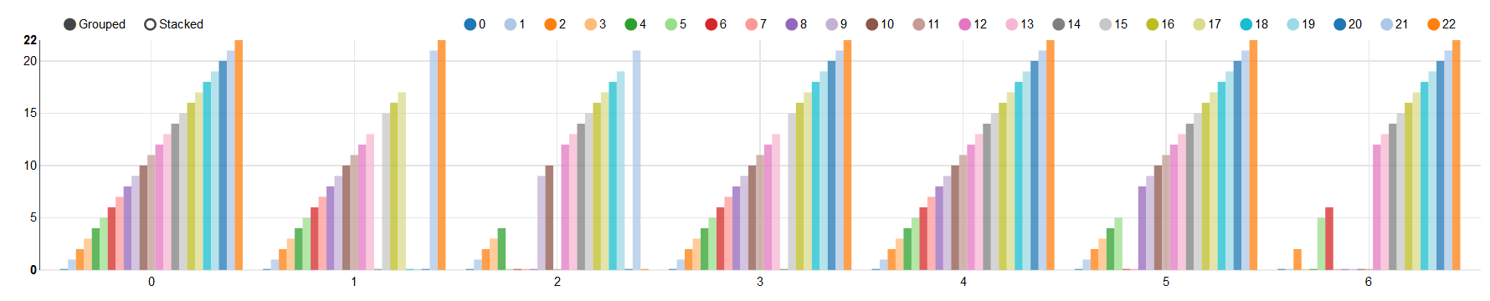
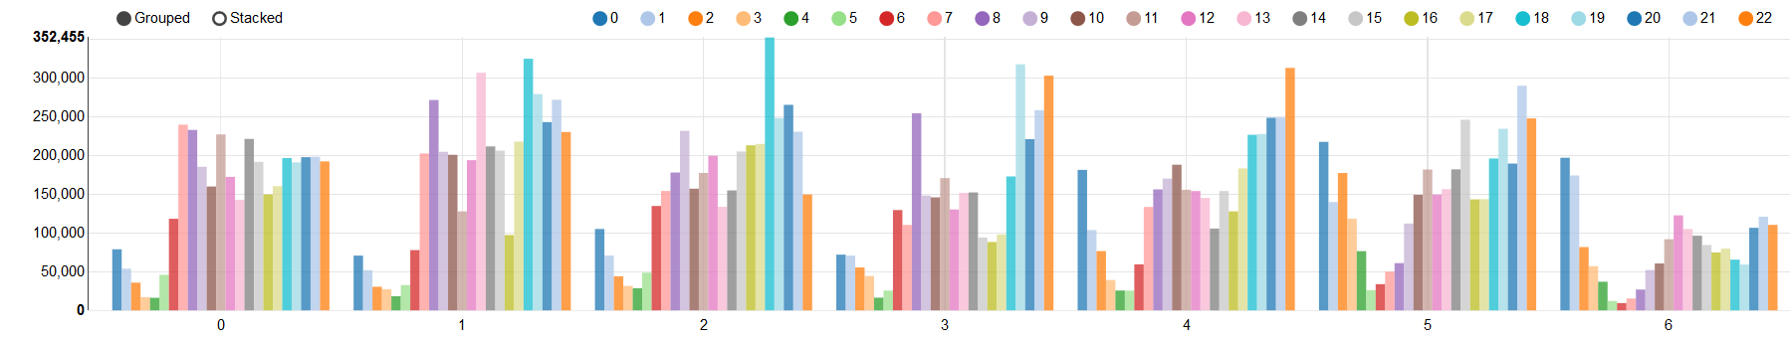
NYC TAXI DATA ANALYSIS
6. WEATHER- SNOW
7. WEATHER- RAIN

Slide 7
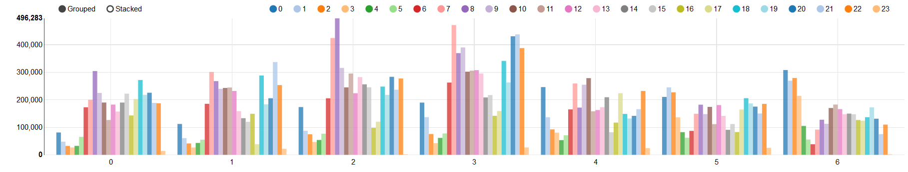
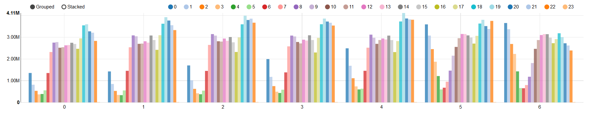
NYC TAXI DATA ANALYSIS
8. WEATHER- FOG
9. WEATHER- NORMAL

Slide 8

K-MEANS
?
Classical and powerful clustering algorithms
Get the center point of each cluster
Built in Spark MLlib
How to analyze
the position

Slide 9
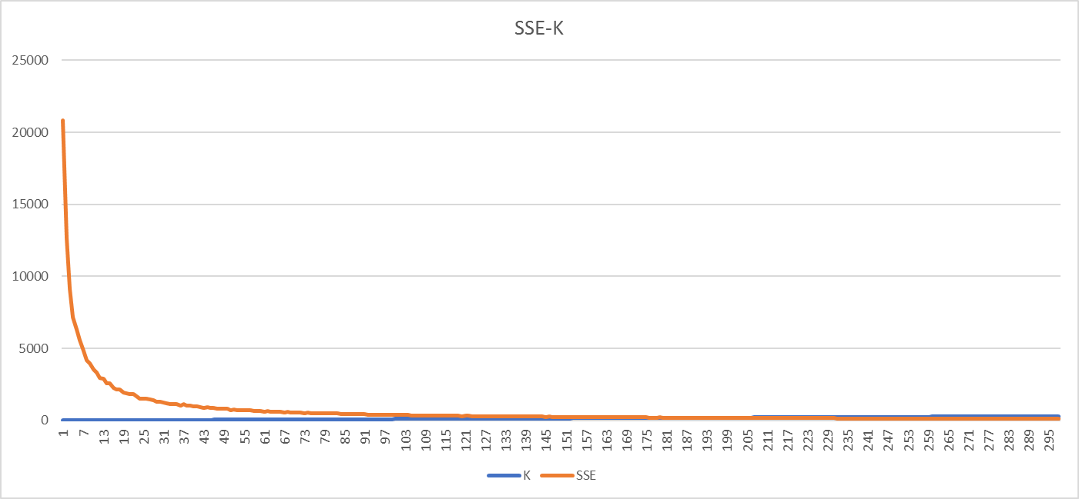
K-MEANS
HOW TO CHOOSE K?
Draw the SSE-K Diagram
Chose 150 as the K

Slide 10
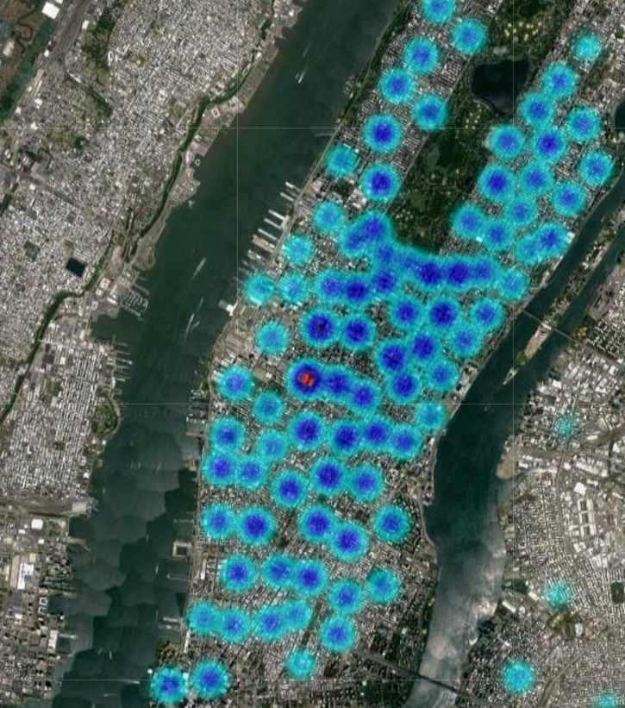
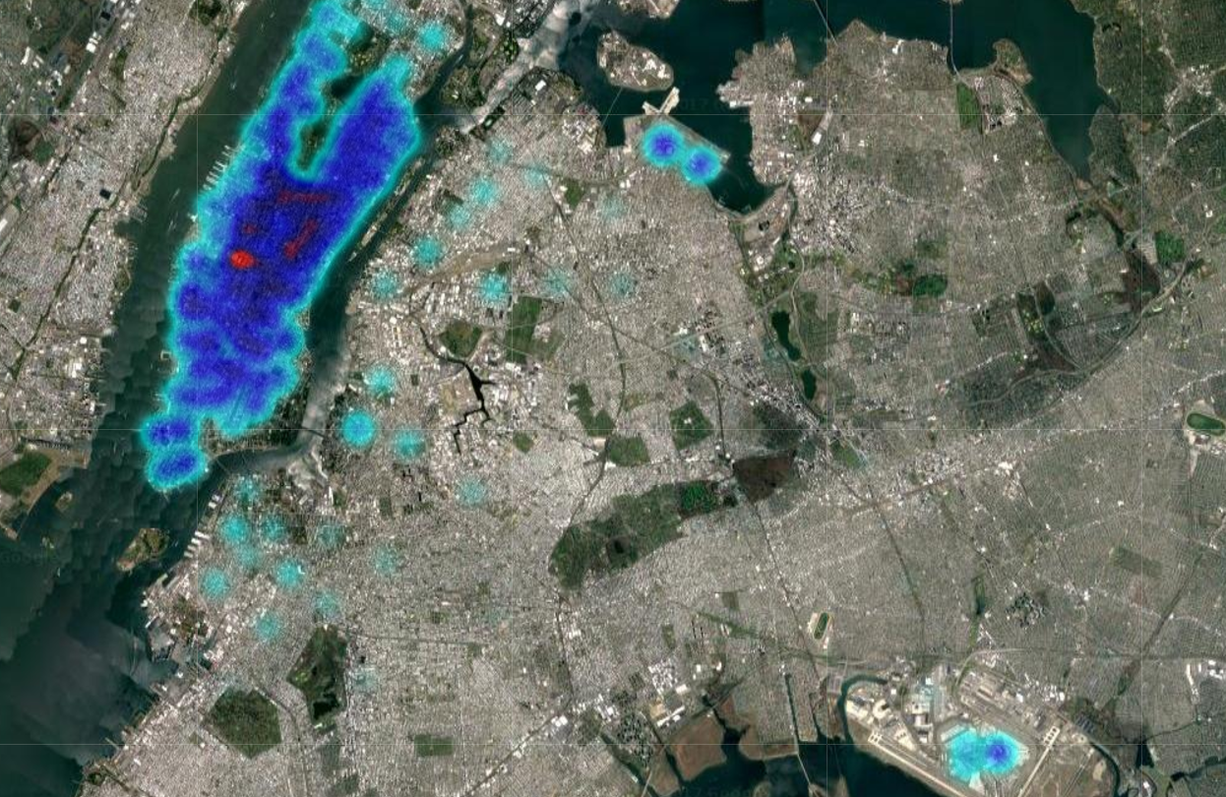
K-MEANS
VISUALIZATION

Slide 11
PREPARE DATA AND EXTRACT FEATURES
Date | Weather | Temperature | Latitude | Longitude | Number
2015-01-15 19 | normal | 0.6 | 40.75051 | -73.99389648 | 18
StringIndexer
Hour: 0 - 23
Day 0f week: 0 - 6
K-Means Cluster Model:
0 - 149
Hour | Day of Week | Weather Index | Temp | Cluster Center | Number
19 | 3 | 0 | 0.6 | 73 | 18

Slide 12
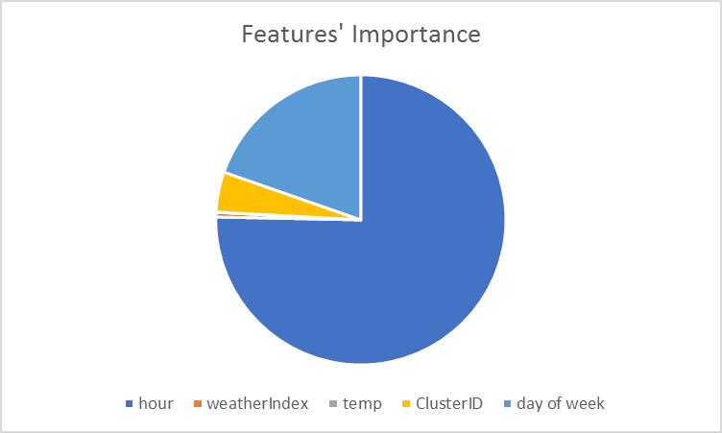
RANDOM FOREST REGRESSOR
Overall Result:
RMSE: 127
Importance:
Separated Dataset:
Subset | Pick Up | RMSE
1 | <100 | 25
2 | 100 - 300 | 52
3 | 300 - 1000 | 100
4 | > 1000 | 105

Slide 13
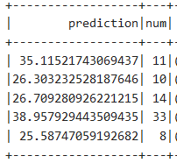
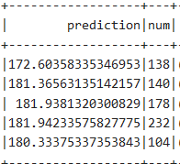
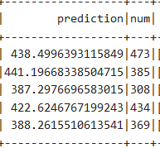
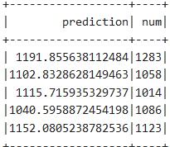
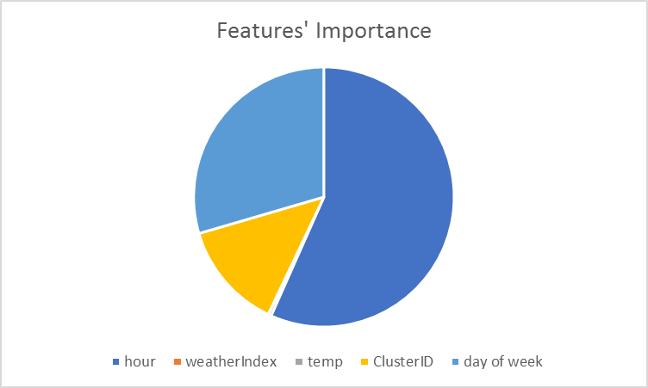
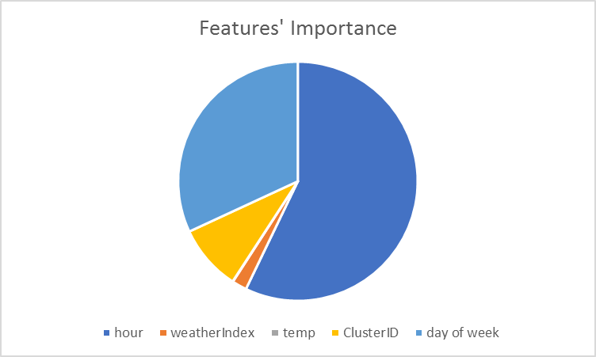
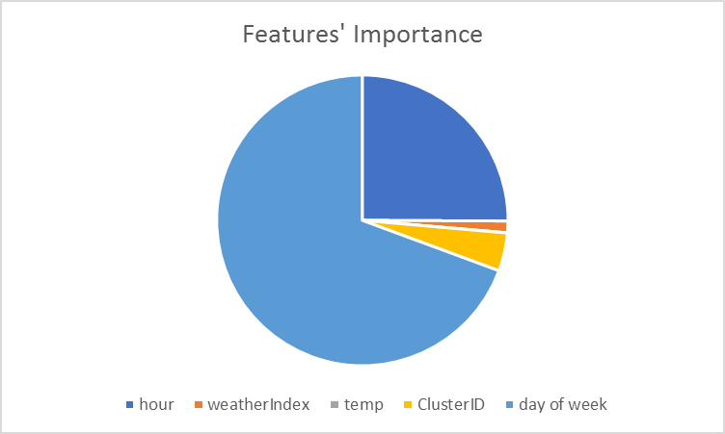
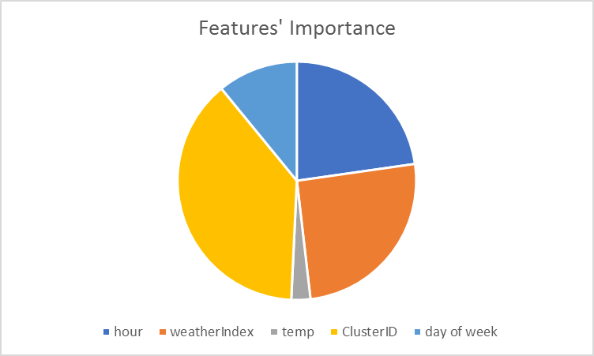
PREDICTION RESULT
Subset: num < 100
Subset: 100 < num < 300
Subset: 300 < num < 1000
Subset: num > 1000

Slide 14
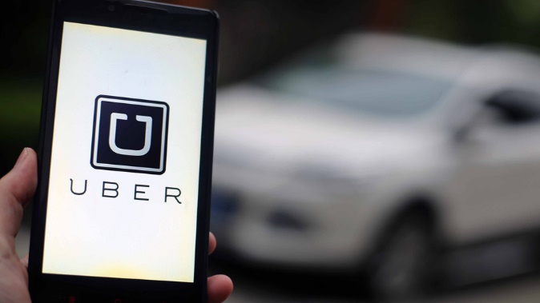
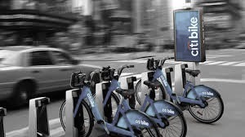
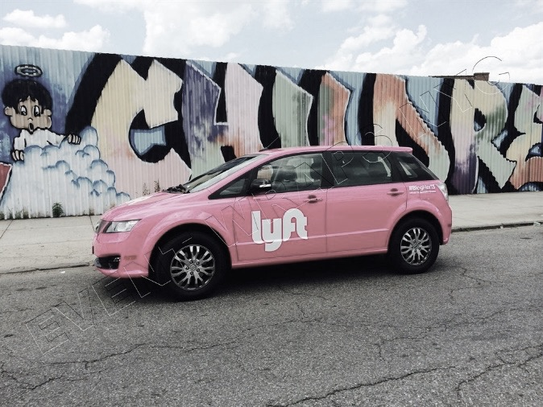
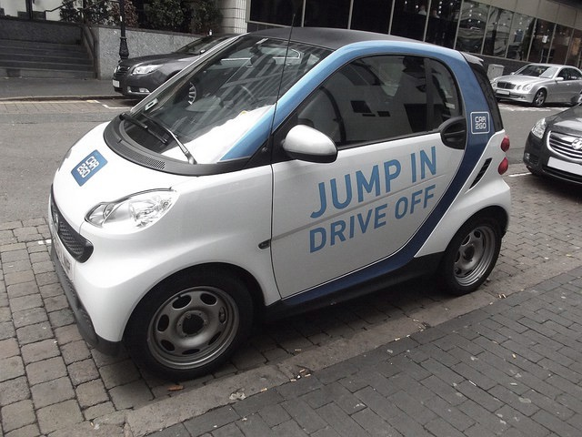
Exploring Change of the
Forms of Transportation
Newcomers:
City Bike
Uber
Lyft
car2go
Will Uber overtake traditional taxis ?
Will City Bike become more popular
in future?
Has City Bike made some influence
on taxis?
……

Slide 15
TRANSPORTATION
DATA ANALYSIS
Notes:
We can find that Car2go only have 550 cars, when compared with taxi or uber cars, it can be ignored.
And We get more than 10 000 city bikes in NYC, nearly the same number with Yellow taxis, will it make huge difference? The answer is no.
We also get 4 times uber cars than yellow taxis, So does the uber get more trips than yellow taxi? No,too

Slide 16
TRANSPORTATION
DATA ANALYSIS
Notes:
We got taxi and bike data from 2013 to 2016, uber and lyft data from 2015 to 2016
From the graph we can find the uber and lyft get more and more popular in NYC, the corresponding influence is the obvious deceasing for the traditional taxi tips
We also find that the city bike seems have a pretty low increase rate. Why? Let’s find more details for citybike

Slide 17
TRANSPORTATION
MORE DETAILS IN CITY BIKE
Top10 Bike Route
Notes:
First let us find the top10 bike ride routes (we select these routes which contains taxi ride data in range 300 meters. So we drop some routes without taxi data nearby such as rides on governors island )
These two routes are start and end at the same section.(obvious, most of them are on their way to central park)
Back to our data, the graph is showing the number of trips for the bike and taxi which has the same route. (decide by start location and end location)
For viewing data better, I set the vertical coordinates as Logarithmic , and they have significant quantitative differences
Which lead to our conclusion, city bike are not treating as a substitution for taxi.
But is bike not applicable when compared with taxi?

Slide 18
TRANSPORTATION
MORE DETAILS IN CITY BIKE
Top10 Bike Route
Notes:
This graph shows average trip duration for bike and taxi with same route.
First let’s check the most remarkable one, ok , they are the tourists for central park.
Besides these two routes, We can find that bike trips always has a shorter trip duration when compared with taxi.
So if u are in a hurry and you are in Manhattan, get a bike instead of a taxi.

Slide 19
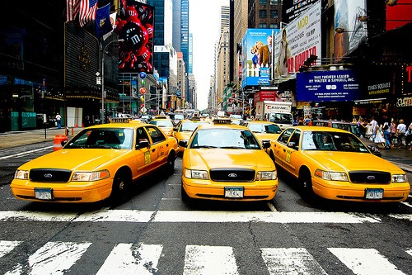
THANK YOU
THANK YOU
NYC Taxi Data Analysis
Yuankai Wang • Luyao Chen • Yalin Zhuang

